Slide 1

Netflix 2017 Stock Analysis
Python Data Visualization and Interpretation

Slide 2
This is a simple presentation designed to graphically represent and interpret Netflix’s stock prices in 2017 based on data from Yahoo Finance, and comprises of the following visualizations constructed using Python:
Netflix stocks vs general stock market (DJIA)
Quarterly distribution of stock prices
Revenue vs Earnings
Estimated vs Actual Earnings

Slide 3
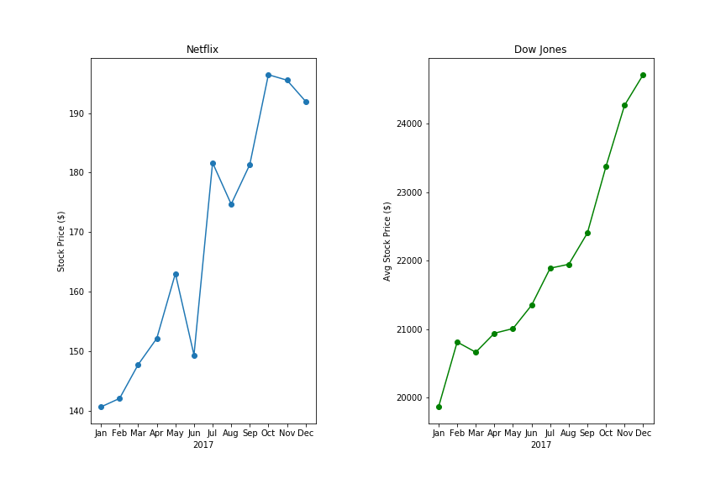
Netflix vs DJIA
General trend for both is upward
Netflix’s performance saw a 35% increase over the year as compared to a 20% increase overall, thus beating the average
Dip from July to August is echoed faintly in a slowing of The Dow; that of May to June slightly less so

Slide 4
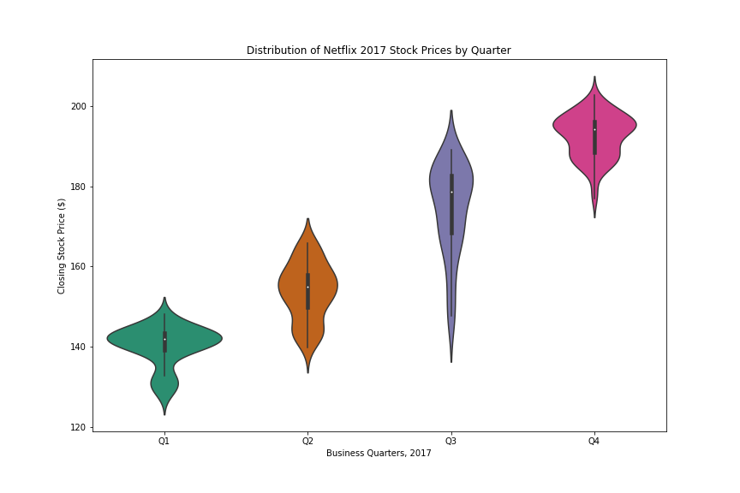
Quarterly Distribution
Quarters 1, 2 and 4 are characterised by similar price fluctuations/rises
Prices in 3rd quarter distributed more widely, the bulk however leaning towards the higher end, as also represented by the interquartile range

Slide 5
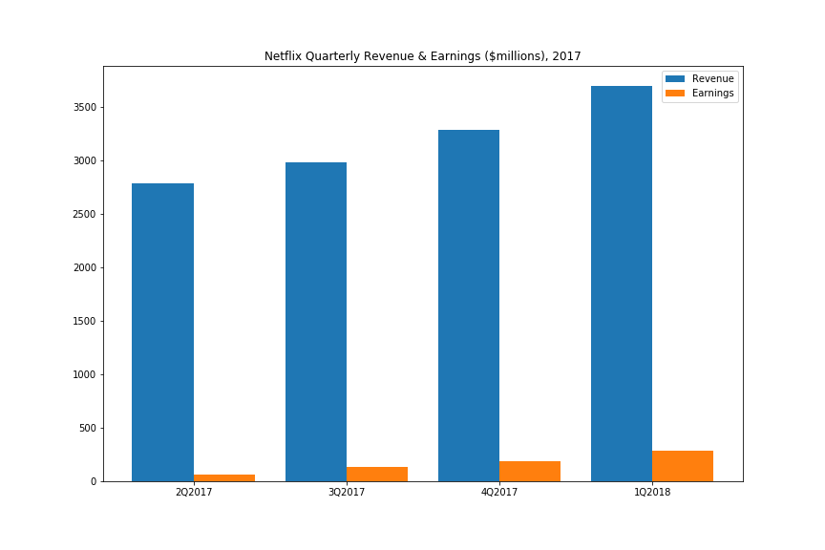
Revenue vs Earnings
Rises in revenue are followed by earnings
Earnings as a proportion of revenue are, respectively, 2.4%, 4.3%, 5.6% and 7.8%

Slide 6
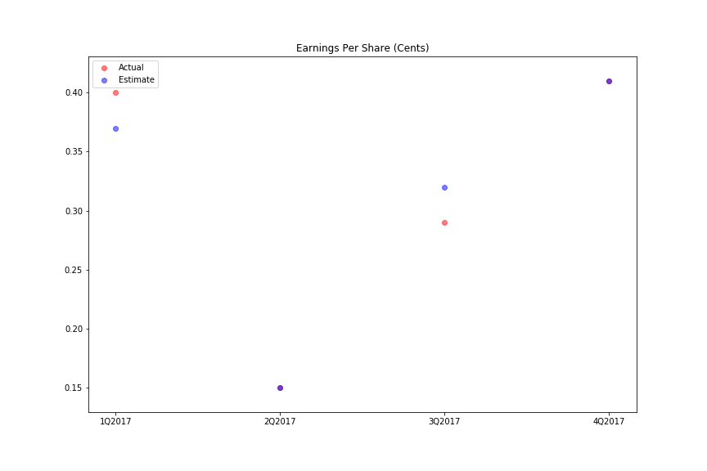
Estimated vs Actual Earnings
1st quarter, actual earnings were higher than estimated
3rd quarter, actual earnings were lower than estimated
Earnings were correctly predicted in the 2nd and 4th quarters

